Slide 1

Group 6
Cortney Wilson, Lupe Perez, Kayla Vincent & Christian Martinez

Slide 2
Team Member Roles
Cortney Wilson (System Analyst)
Lupe Perez (Co-Project Owner)
Kayla Vincent (Business Analyst)
Christian Martinez (Programming/Database Coordinator)

Slide 3
Company Background
Chatham County Schools governs the school system in Chatham County, North Carolina. Their website is a hub for K-12 information, enrollment details, academic calendar, and educational programs, serving twenty schools and over 8,900 students county.
Chatham Early College enables high-achieving students to earn an associate’s degree with their high school diploma. Students apply for limited seats through a Google Form for ease-of-use College.

Slide 4
Current Environment
An interested student or parent will go to the Chatham County Schools website and search for the Early College. There, they will find the Chatham Early College application link, which directs them to a Google Form.
The applicant only needs their Google email to complete the form. They fill out the information, which is then sent from the Google Form to a Google Sheet, collecting all data in one spreadsheet for administrators to review. Once the data is transferred, a script triggers an email with a reference form for a staff member or acquaintance to complete. This form will be submitted and stored in a separate folder within the application data set on Google Drive.

Slide 5
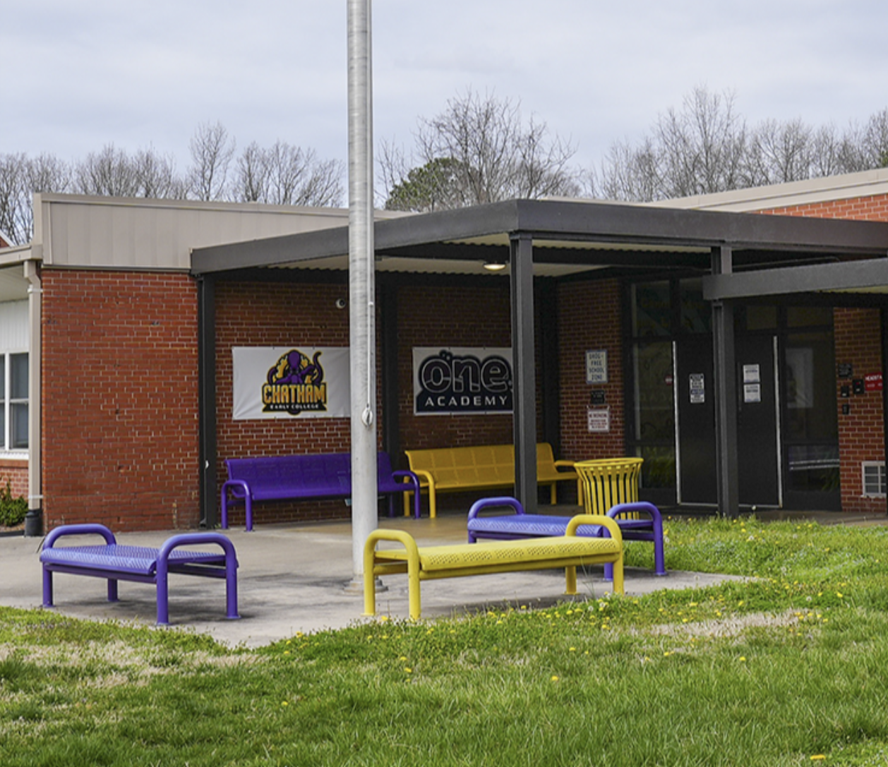
Why This?
The Early College asked me to develop an application that would automatically send reference emails when students submitted their forms. Once the referenced individual completes the form, it will be directed to a designated folder in Google Drive. This process will reduce the need to revisit the application after each student submission, thus saving time and minimizing errors.

Slide 6
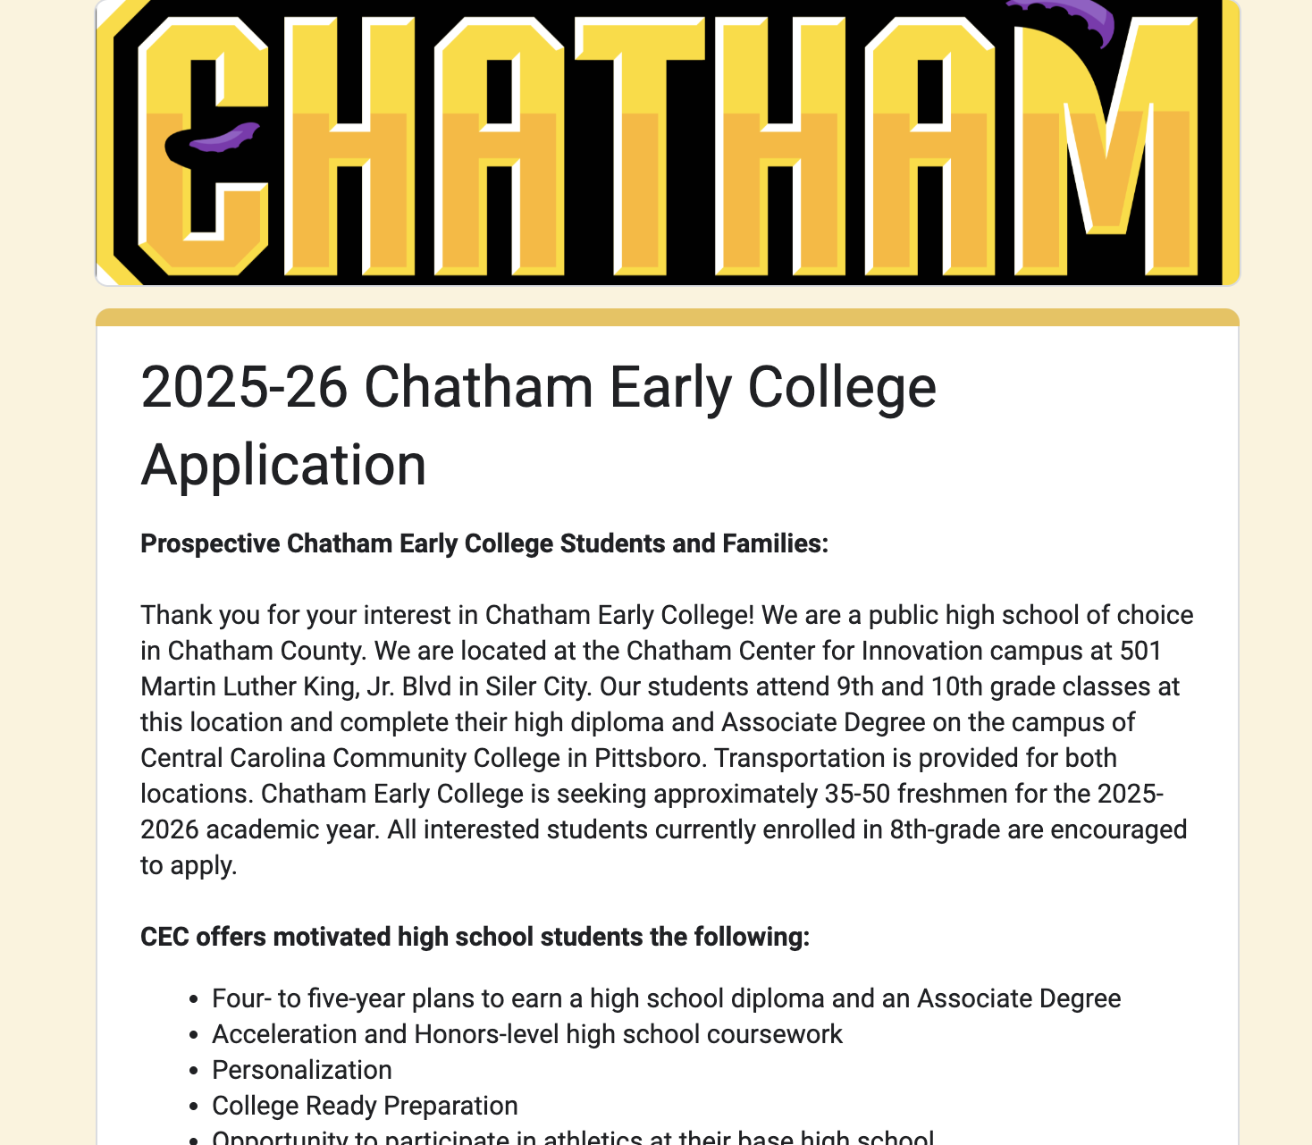
Current system problems
Google Form
Data Security & Storage
Efficiency

Slide 7

Problem Analysis: Business Process Improvement
Need to simplify an existing process- Automation/Reengineering, Streamlining
The current process for student applications lves Google Forms with limited unctionality
Information sent to Excel spreadsheet
Form unable to communicate with a database meeting required security requirements for a government entity

Slide 8
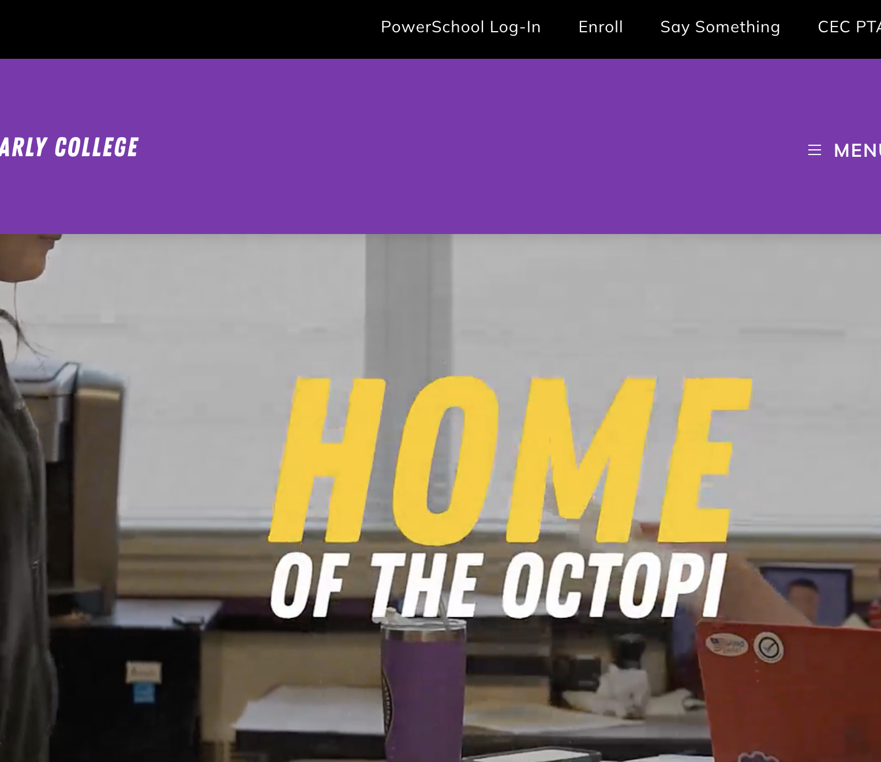
Project Objective
Design a user interface for applications that enables users to upload their information to apply for the Chatham Early College. This information will be sent to a database from which early college administrators can access data to evaluate applicants.

Slide 9
Requirements
Data must be securely transferred and secured
Form needs to be clear and easy to understand
Database should use a rational structure
Database needs to store all answers in the appropriate format

Slide 10
Project Expected Benefits
Data is stored in a more secure fashion in an actual database
Data being in a database means it is connected in more uniform matter
New Application form will be linked to the database improving customer experience
New Application will give district more control over it and will be easier to update with the database and changing business climate

Slide 11
Project Constraints
We are not creating a login system for the interface
We are not creating the portal for the Administrators to pull the data from
Once the project is complete it is up to the company maintain

Slide 12
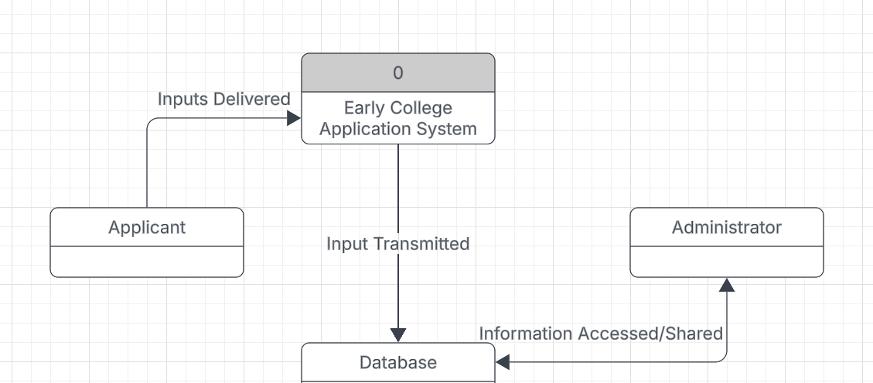
Context diagram

Slide 13
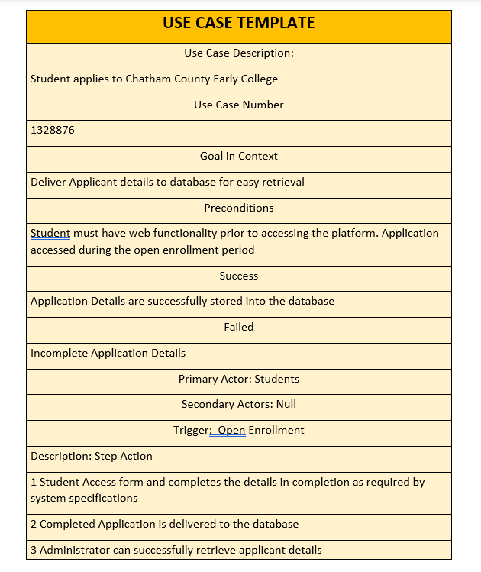
Use Case Diagram

Slide 14
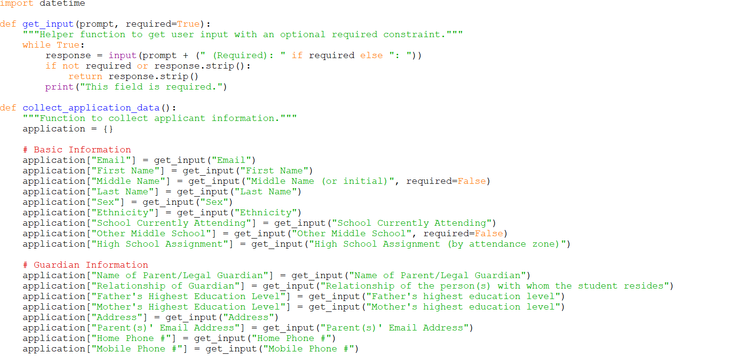
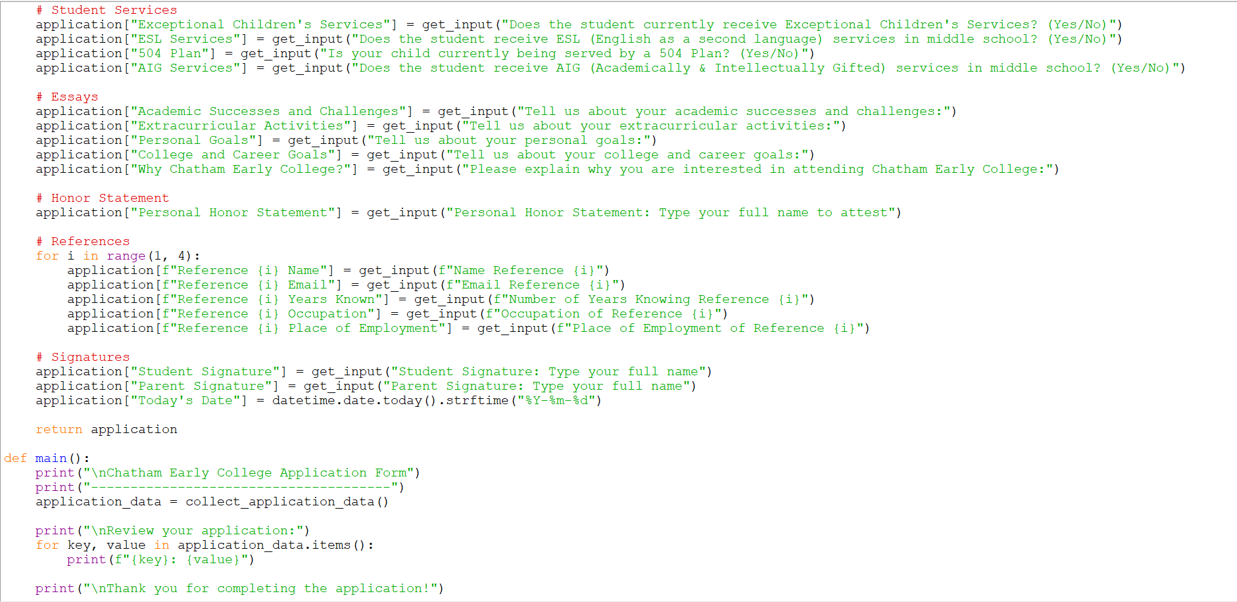
PSPI

Slide 15
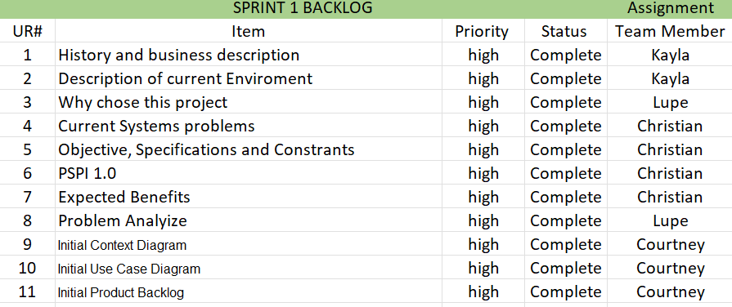
Backlog

Slide 16
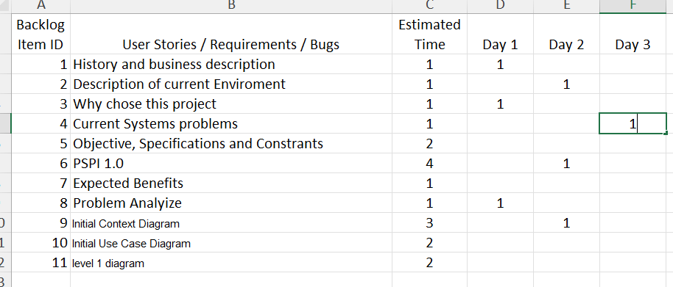
Burndown

Slide 17

Questions or Comments?

